Slide 1

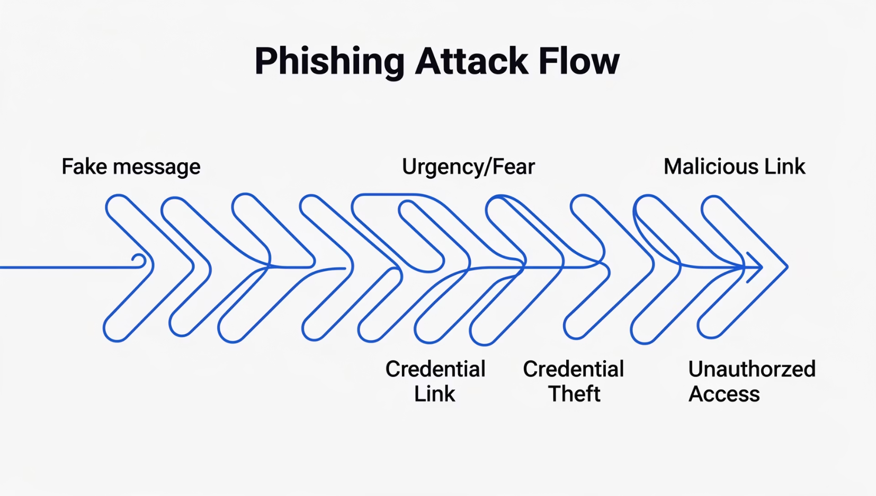

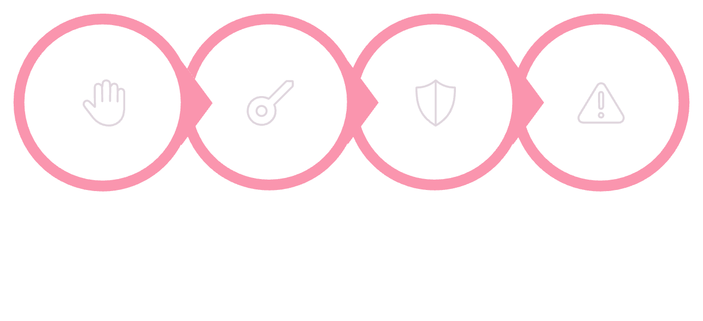
Phishing Awareness Training
How to Recognize Phishing Emails and Fake Websites
Prepared by Parimi Pujitha · Internship: CodeAlpha
CYBERSECURITY
STAY ALERT
PROTECT YOURSELF
Phishing is a cyberattack where attackers impersonate trusted entities to steal passwords, OTPs, banking details, and personal data. It causes financial loss, identity theft, malware infections, and organizational damage.
Types of Phishing Attacks
Email Phishing
Spear Phishing
Smishing
Fake emails with malicious links
Personalized attacks on specific targets
Phishing via SMS/text messages
Vishing
Fake Website Phishing
Social Media Phishing
Voice calls impersonating trusted parties
Fraudulent sites stealing credentials
Attacks through fake profiles and messages
Quishing
Malicious QR codes redirecting to harmful sites
How Phishing Emails Work
Each step exploits human psychology — urgency, fear, and trust — to bypass rational thinking and steal sensitive information.
Signs of a Phishing Email
🚨 Red Flags to Watch For
✅ Real vs. Fake Email
Suspicious sender address (e.g., @gmai1.com)
Grammar mistakes and poor formatting
Urgent or threatening language
Fake or mismatched links
Unknown attachments
Requests for OTPs or passwords
Real Email
Fake Email
Official domain (@bank.com)
Misspelled domain (@bank-secure.xyz)
Professional tone
Urgent, threatening language
No password requests
Asks for OTP or password
Correct grammar
Spelling and grammar errors
Recognizing Fake Websites
🔒 Check HTTPS
🔍 Inspect the URL
🎨 Poor Design & Popups
Legitimate sites use https:// with a padlock icon. Missing HTTPS is a major red flag.
Watch for typosquatting: paypa1.com vs paypal.com. Attackers swap letters for numbers.
Fake sites often have broken images, inconsistent fonts, and suspicious popups requesting credentials.
Social Engineering Tactics
Attackers exploit human psychology to manipulate victims into revealing sensitive information:
Urgency
Fear
Curiosity
"Act now or your account will be suspended!"
Threats of account closure or financial loss
"You've won a prize! Click to claim."
Authority
Trust Exploitation
Impersonating banks, government, or IT support
Mimicking colleagues or known brands
Real-World Phishing Scenarios
🏦 Fake Bank Email Example
✅ Correct User Response
From: support@secure-bank-login.xyz
Subject: URGENT: Your account will be suspended!
Body: "Click here to verify your identity within 24 hours or your account will be permanently locked."
Do NOT click the link
Verify sender's email address
Visit the bank's official website directly
Contact the bank through official channels
Report the phishing email
This email uses a fake domain, urgent language, and a malicious link to steal banking credentials.
Famous Real-World Phishing Attacks
2013–2015: Google & Facebook Scam
Ongoing: Banking Phishing Frauds
Lithuanian fraudster impersonated a vendor, stealing $100M+ through fake invoices.
Fake bank portals continue to steal millions in credentials and financial data.
1
2
3
2020: COVID-19 Phishing Wave
Fake WHO and CDC emails spread malware and stole credentials globally.
Key Lesson: Even large corporations are vulnerable. Always verify requests, even from known contacts.
How to Stay Safe — Best Practices
01
02
03
Verify Sender Addresses
Avoid Unknown Links
Use Strong, Unique Passwords
Always check the full email address, not just the display name.
Hover over links to preview URLs before clicking.
Use a password manager for complex, unique passwords.
04
05
Enable Two-Factor Authentication (2FA)
Use Antivirus & Update Devices
Add an extra layer of security beyond just a password.
Keep security software and operating systems up to date.
What to Do If You Suspect Phishing
Stop
Change
Scan
Report
If you clicked a link or entered credentials, contact your bank immediately and monitor accounts for suspicious activity.
Safe vs. Unsafe — Quick Comparison
Category
✅ Safe
🚨 Unsafe
Website URL
https:// with padlock
http:// or misspelled domain
Email Sender
Official domain address
Free email or look-alike domain
Attachments
Expected, from known sender
Unexpected .exe or .zip files
Password Requests
Never asked via email
Email asks for password/OTP
Language Tone
Professional, calm
Urgent, threatening, or overly friendly
🧠 Interactive Quiz — Test Your Knowledge!
1
2
3
Should you share OTPs through email?
Which URL is most likely fake?
What does HTTPS indicate?
A) Yes, if requested by your bank
B) No, never share OTPs with anyone ✅
C) Only via encrypted email
A) https://www.paypal.com
B) https://www.paypa1.com ✅
C) https://www.amazon.com
A) The site is completely safe
B) The connection is encrypted ✅
C) The site is owned by the government
4
5
What is social engineering?
An email creates urgency — what do you do?
A) A type of antivirus software
B) Manipulating people to reveal information ✅
C) A secure login method
A) Click the link immediately
B) Pause, verify sender, and investigate ✅
C) Forward to all colleagues
🔍 Bonus Activity — Spot the Phishing Signs!
Examine this sample phishing email and identify the hidden red flags:
From: "Microsoft Security" <support@m1crosoft-alert.com>
Subject: ⚠️ URGENT: Suspicious login detected on your account!
Body: "We detected an unusual login attempt. Your account will be suspended in 24 hours unless you verify your identity. Click here to secure your account now. — Microsoft Security Team"
Link: hxxp://m1crosoft-verify.xyz/login
🔴 Fake Domain
🔴 Urgency
🔴 Malicious Link
🔴 Generic Greeting
m1crosoft-alert.com (not microsoft.com)
"Suspended in 24 hours" pressure tactic
m1crosoft-verify.xyz is a fake domain
No personal name, uses "your account"
🛡️ Key Takeaways
Think Before You Click
Verify Emails & URLs
Pause and evaluate every link and attachment.
Check sender addresses and website URLs carefully.
Never Share Passwords or OTPs
Stay Alert Online
Legitimate organizations never ask for credentials via email.
Cybersecurity is everyone's responsibility — stay vigilant.
Conclusion
Cybersecurity awareness is not optional — it is essential. Phishing attacks are becoming more sophisticated, but with the right knowledge and habits, you can protect yourself and your organization. Remember: the human element is both the weakest link and the strongest defense.
Thank You! 🎉
Stay Safe Online
Prepared by Parimi Pujitha · Internship: CodeAlpha
CYBERSECURITY AWARENESS
PHISHING PROTECTION
STAY VIGILANT
"The only truly secure system is one that is powered off, cast in a block of concrete and sealed in a lead-lined room with armed guards." — Gene Spafford
Parimi Pujitha

